Slide 1
Geek out : The ultimate Quiz
Chaime Leaboub
Python, Front end, Unity
2023 – 2024
Notes:
1. INTRODUCTION

Slide 2
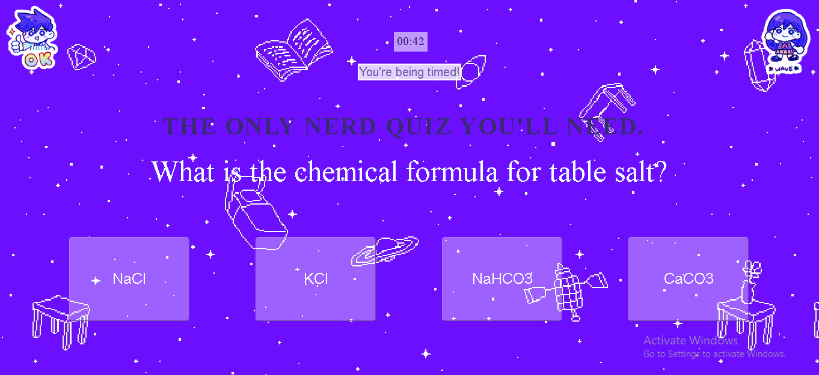
Notes:
My project is a quiz made for nerds, basically it acheives to collect data based on the users answers which could help with personalizing ads and help out small cooperations in the entertainment industry

Slide 3




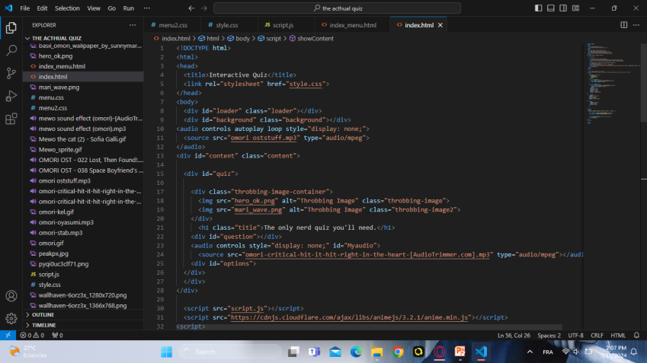
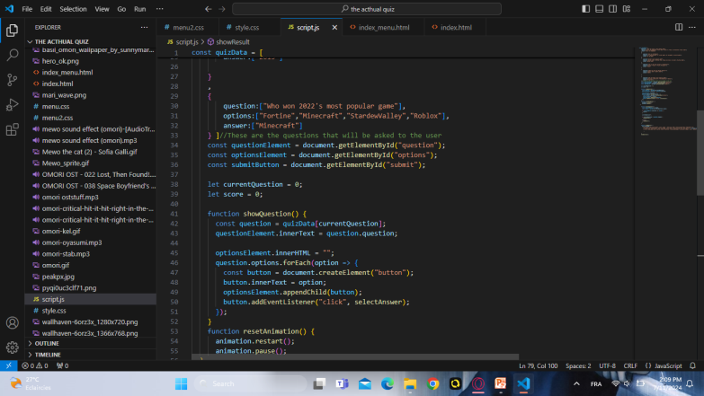
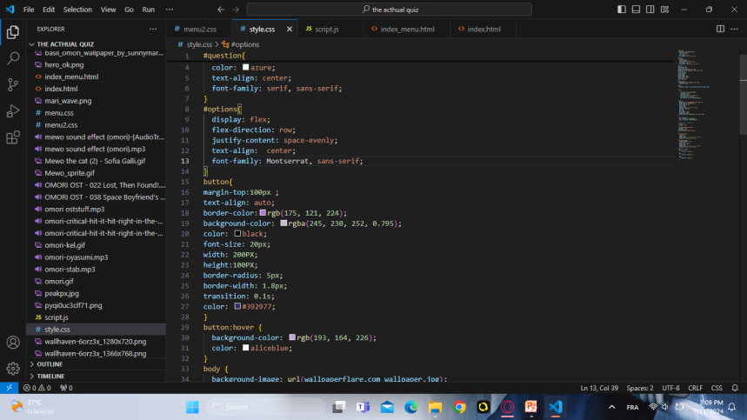
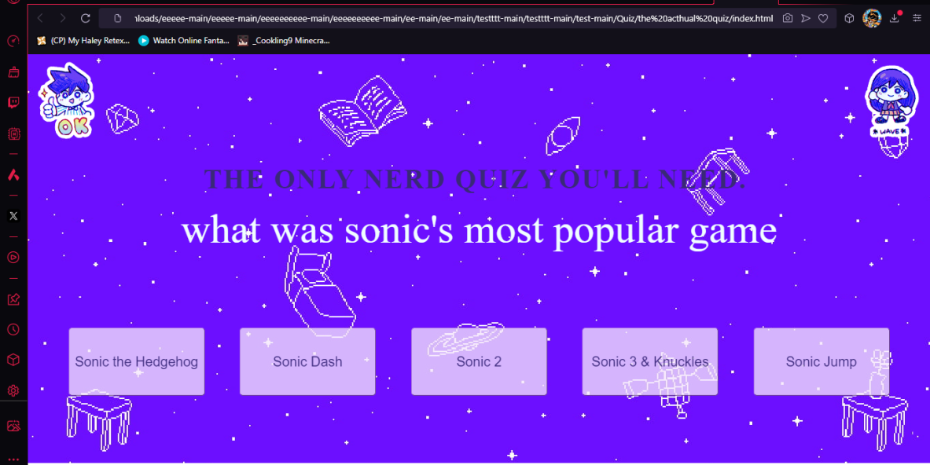
Programming languages
HTML script
JS script
CSS script
Final product

Slide 4
This is a demo of the quiz
<GIF moving image of Project ( if available ) >
<1-sentence value proposition>
IBRAHIM HASSAN

Slide 5
Take action! If you’re interested please contact me here for more information: 0702072823 chaimaeleaboub@gmail.com

